Slide 1
Lecture: Graph Traversals (DFS)

Slide 2


(Important!!!)
Graph traversals
Two common graph traversal algorithms: BFS & DFS
Breadth-First Search (BFS) Start with the source vertex [always] Explores breadth-first (level-wise) Visits all neighbors at the current level before moving to the next. [Similar to ripple effect in water] Uses Queue (FIFO) | Depth-First Search (DFS) Start with the source vertex [always] Explores depth-first, following one path as far as possible before backtracking when all neighboring nodes have been visited (no further choices remain). Recursively visit each neighbor (Recursive call stack) Uses Stack (LIFO)

Slide 3
Vertex Selection Rules in Traversal
Alphabetical options: Choose the alphabetically closest.
Numerical options: Follow stated order (ascending/descending).
No order given / mentioned: Select any option (any neighboring node you want).
Always follow the traversal order specified in the question.

Slide 4
Depth-first search
Starts from an initial vertex.
Recursively visits each adjacent vertex.
Strategy to search deeper into the graph, unlike BFS which fans out.
It explores edges from the most recently discovered vertex with unexplored edges.
After all edges of a vertex are explored, it backtracks to its parent.
If any vertices remain undiscovered, DFS starts again from one of them.
DFS produces a depth-first forest (collection of DFS trees)/DFS tree.

Slide 5
Depth-first search
Information during traversal
color [u]: the color of each vertex visited
  white: undiscovered
  gray: discovered but not finished processing
  black: finished processing
π[u ] or p[u ]: the predecessor of u
d [u ]: the discovery time (or hops from the start) IMPORTANT!!!!!
f [u]: the finish time – when processing of u and all its descendants have finished.

Slide 6
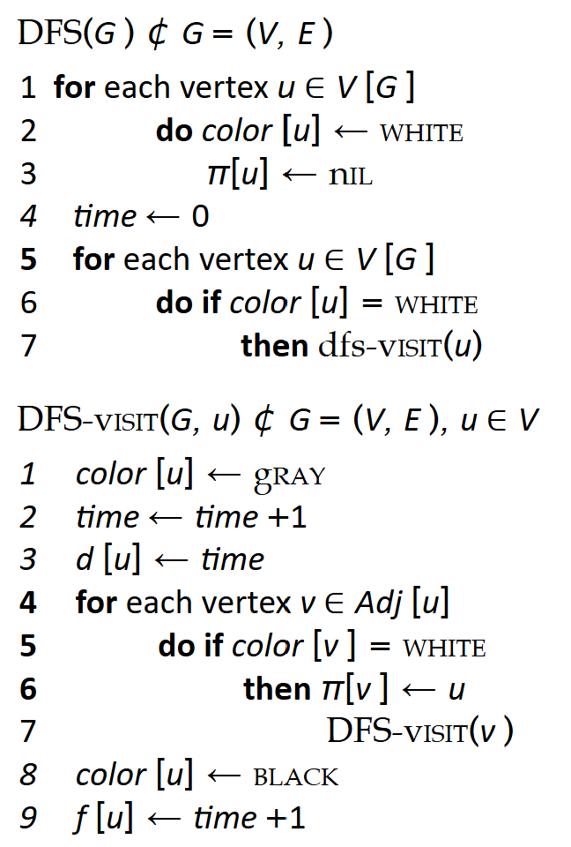
Depth-first search Algorithm

Slide 7
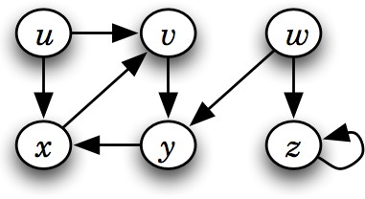
Depth-first search (Simulation 1)

Slide 8
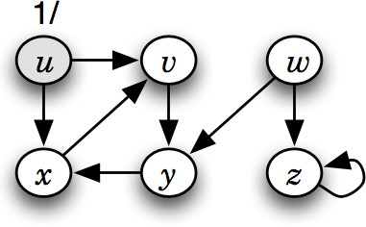
Depth-first search (Simulation 1)

Slide 9
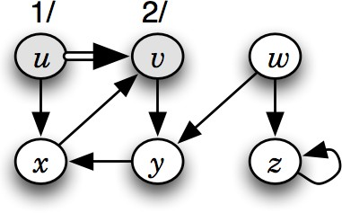
Depth-first search (Simulation 1)

Slide 10
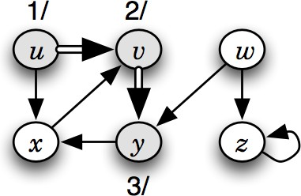
Depth-first search (Simulation 1)

Slide 11
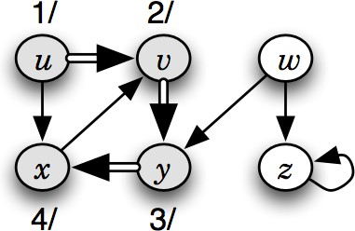
Depth-first search (Simulation 1)

Slide 12
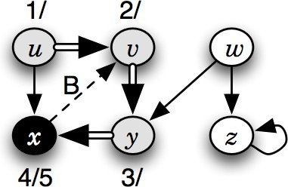
Depth-first search (Simulation 1)

Slide 13
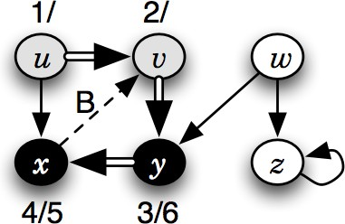
Depth-first search (Simulation 1)

Slide 14
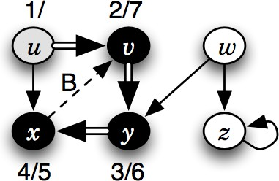
Depth-first search (Simulation 1)

Slide 15
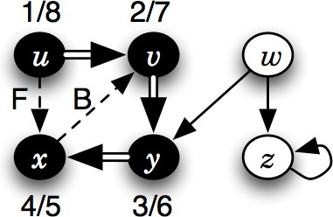
Depth-first search (Simulation 1)

Slide 16
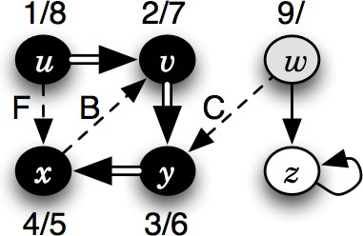
Depth-first search (Simulation 1)

Slide 17
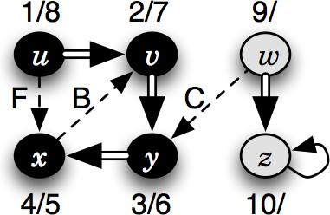
Depth-first search (Simulation 1)

Slide 18
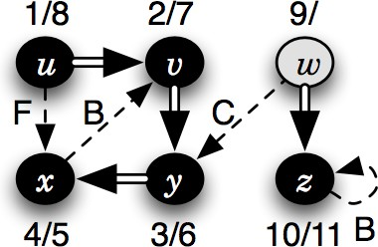
Depth-first search (Simulation 1)

Slide 19
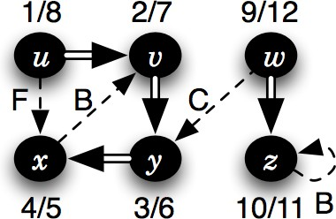
Depth-first search (Simulation 1)

Slide 20
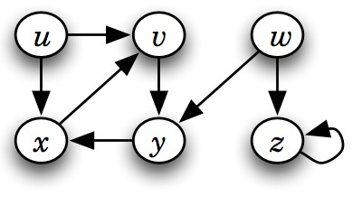
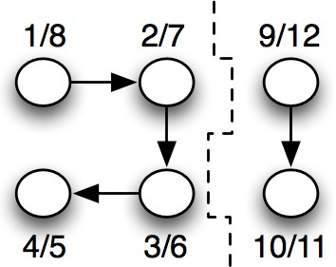
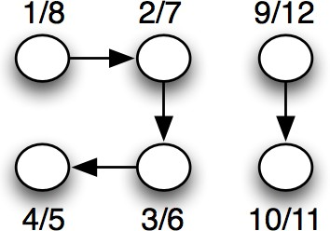
Depth-first search tree or forest

Slide 21
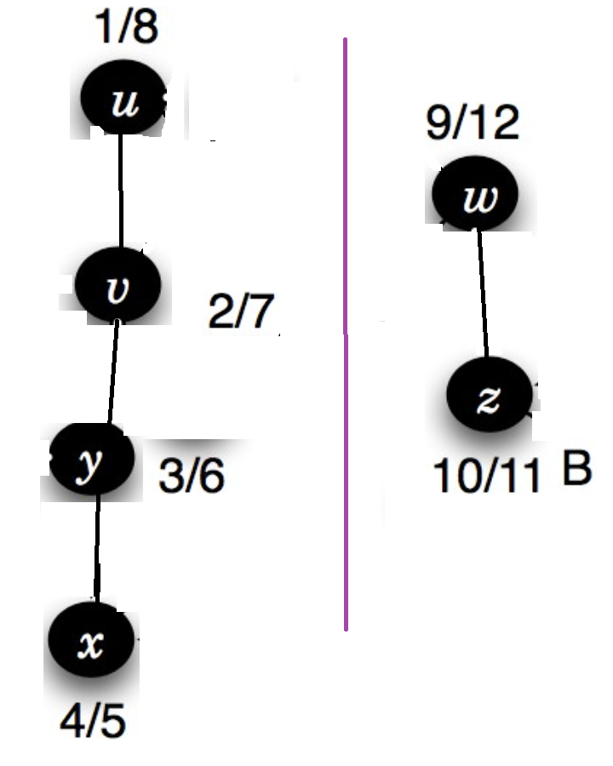
Depth-first search tree or forest

Slide 22
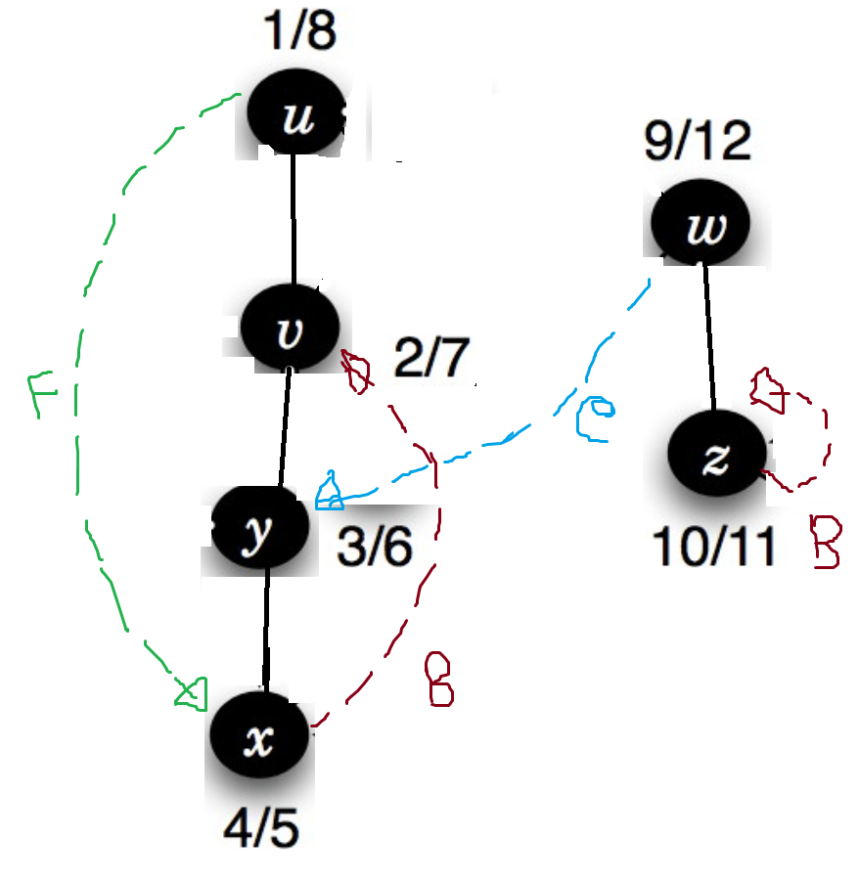
Depth-first search tree or forest

Slide 23
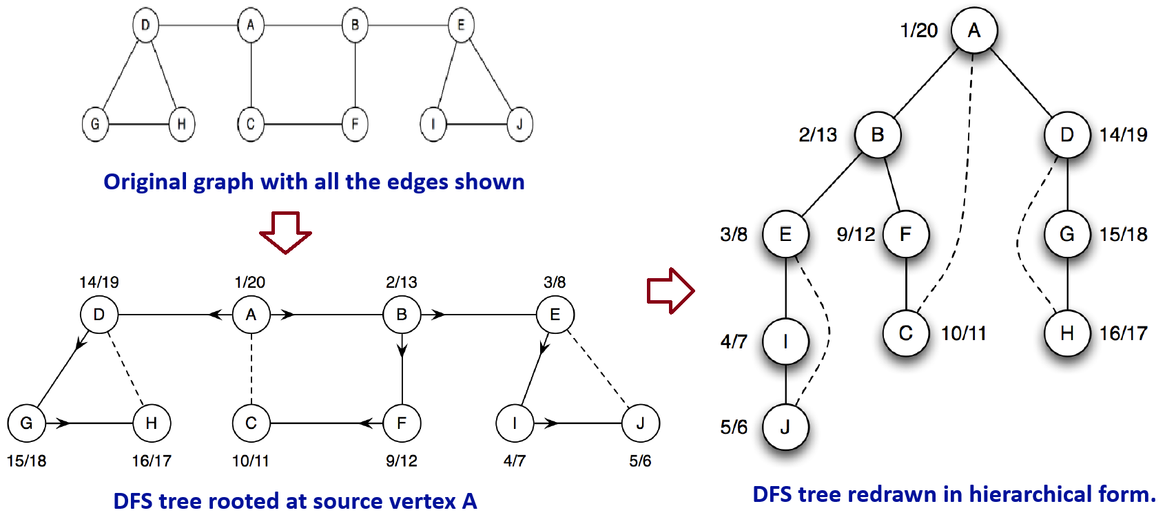
Depth-first search tree

Slide 24
Depth-first search tree
Vertices are annotated with their discovery and finish times.
Arrows point to each vertex’s ancestor.
Solid lines → tree edges.
Dashed lines → non-tree edges (back edges in an undirected graph).

Slide 25
Depth-first search Edges (Not needed for CSE220)
DFS introduces an important distinction among edges in the original graph:
Tree edge: encounter new (white) vertex
Back edge: from descendent to ancestor
Forward edge: from ancestor to descendent
Cross edge: between a tree or subtrees
Note: tree & back edges are important; most algorithms don’t distinguish forward & cross

Slide 26
Depth-first search Edges (Not needed for CSE220)
Application of these 4 edges:
Tree edge:Connects a vertex to a newly discovered vertex, building the DFS tree.
Back edge: Points to an ancestor, identifying a cycle in the graph.
Forward edge: helps in depth classification, topological sorting, and identifying strongly connected components (SCCs).
Cross edge: Connects nodes in different DFS branches or subtrees.
Details of there edges will be covered in CSE221

Slide 27
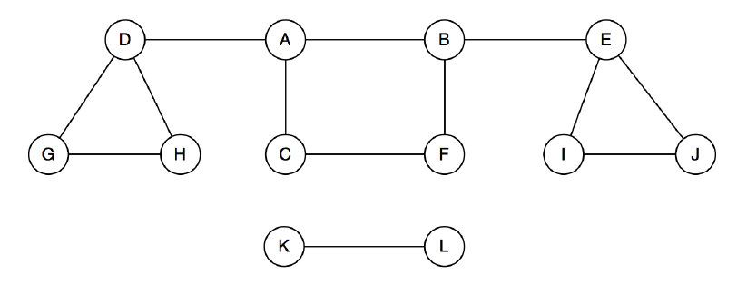
Depth-first search
A single DFS from vertex A visits only its connected component.
Vertices like K and L are not visited if they are not reachable from A.
To visit all vertices, perform DFS from each unvisited vertex.
  This ensures traversal of the entire graph, including all disconnected components.

Slide 28
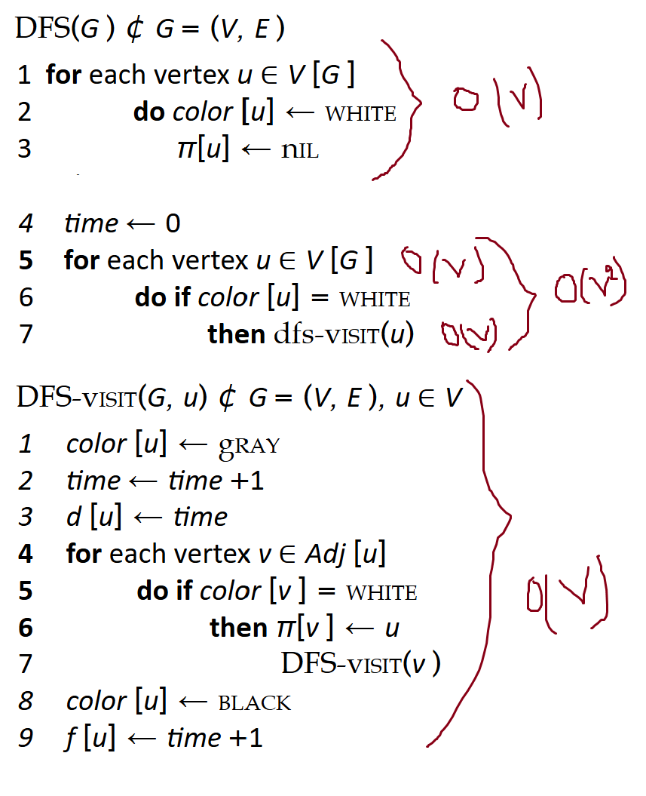
Depth-first search- Analysis
Running time: O(V²) + O(V) = O(V²)
DFS_Visit is called on each vertex
The loop over Adj[] can run up to |V| times per vertex in the worst case
How many times will DFS_Visit() actually be called?

Slide 29
Depth-first search- Analysis
But often DFS is more efficient:
Vertex Processing:
  Each vertex is visited exactly once
  DFS_Visit() is called once per vertex
  So, time required: O(V)
Edge Processing:
  Directed Graph:
  Each edge is explored once → O(E)
  Undirected Graph: Each edge is explored
  twice (once per endpoint) → O(2E) ≈ O(E)
  So, time required: O(E)
So, total time = O(V + E) instead of O(V²)

Slide 30
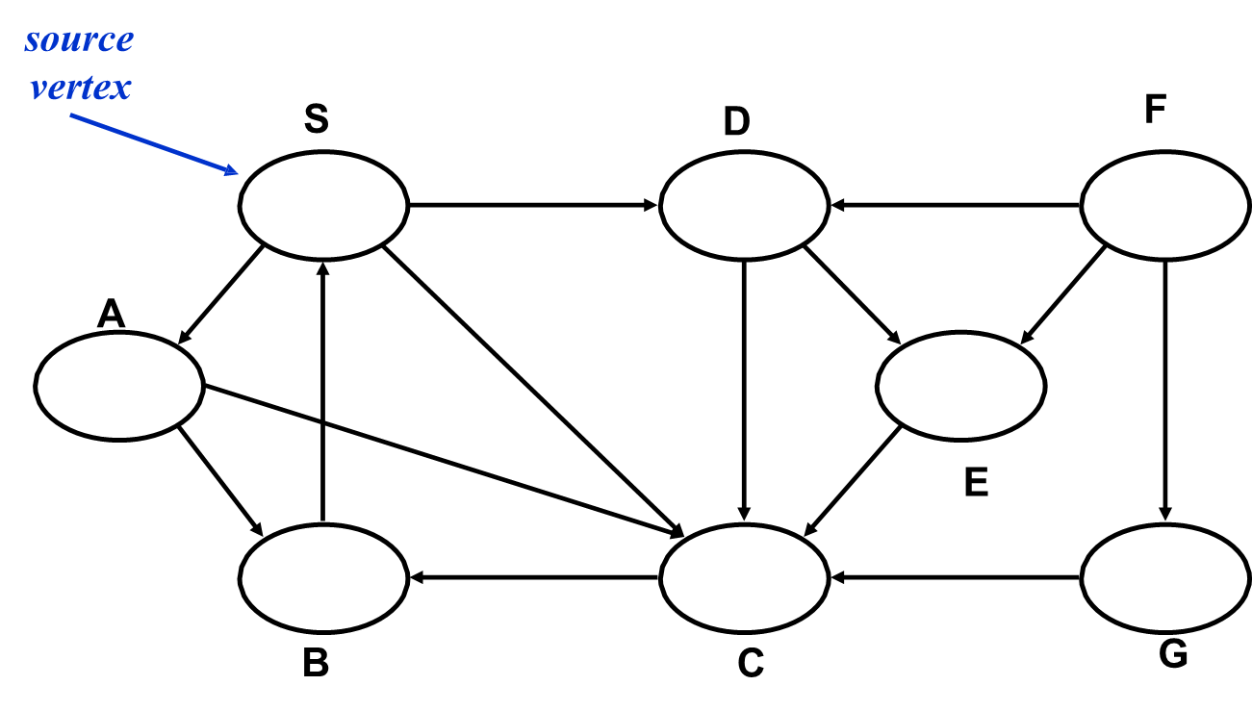
Depth-first search (Simulation 2)
For this example: Choose neighbors alphabetically
20/23

Slide 31
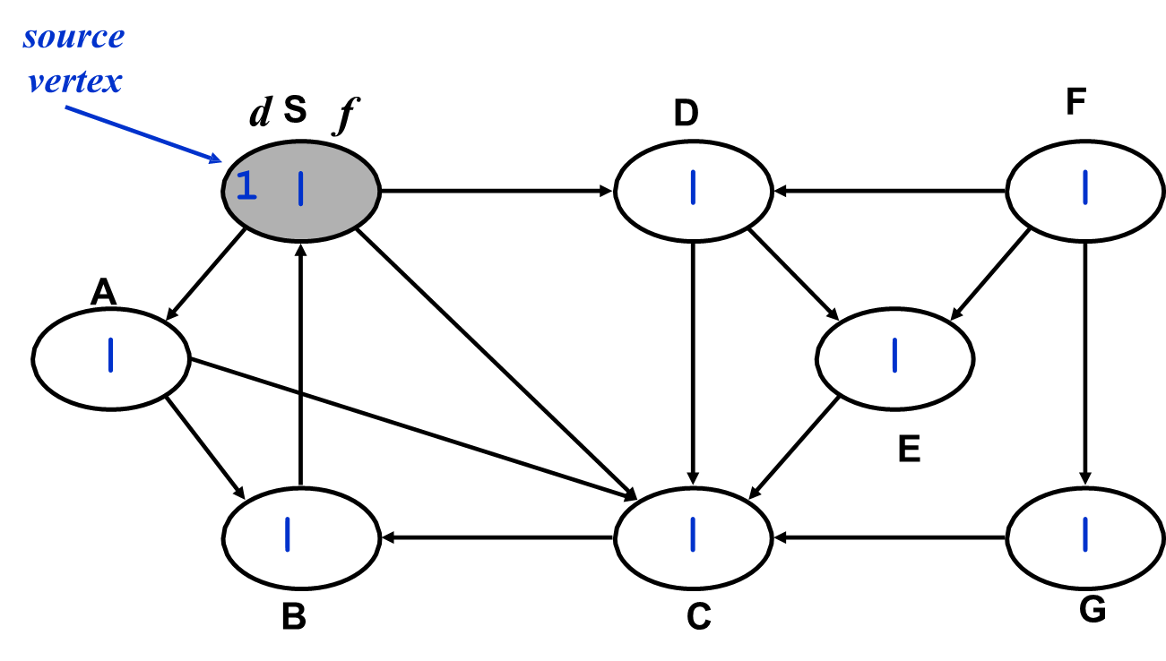
Depth-first search (Simulation 2)
20/23

Slide 32
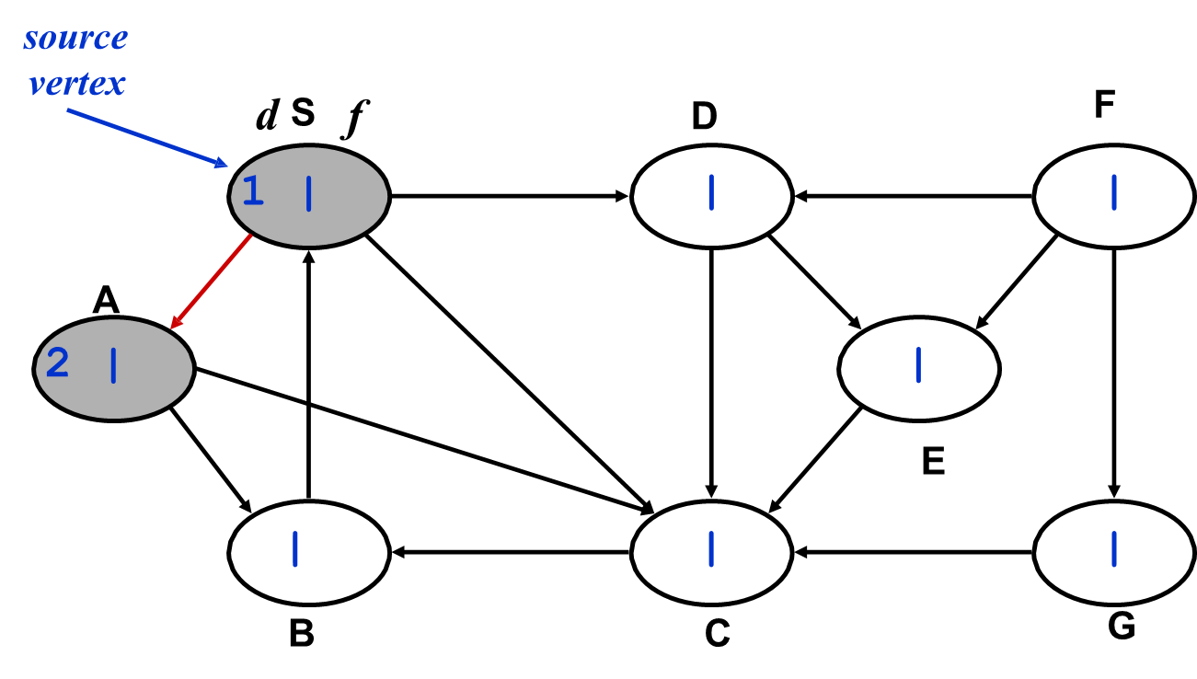
Depth-first search (Simulation 2)
20/23

Slide 33
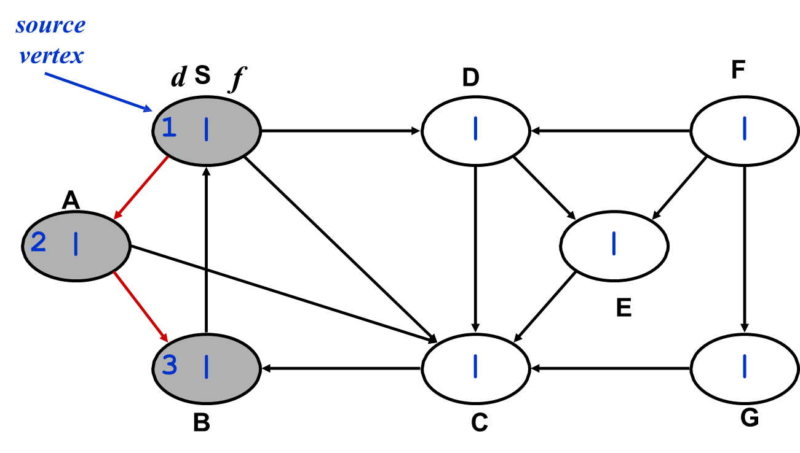
Depth-first search (Simulation 2)
20/23

Slide 34
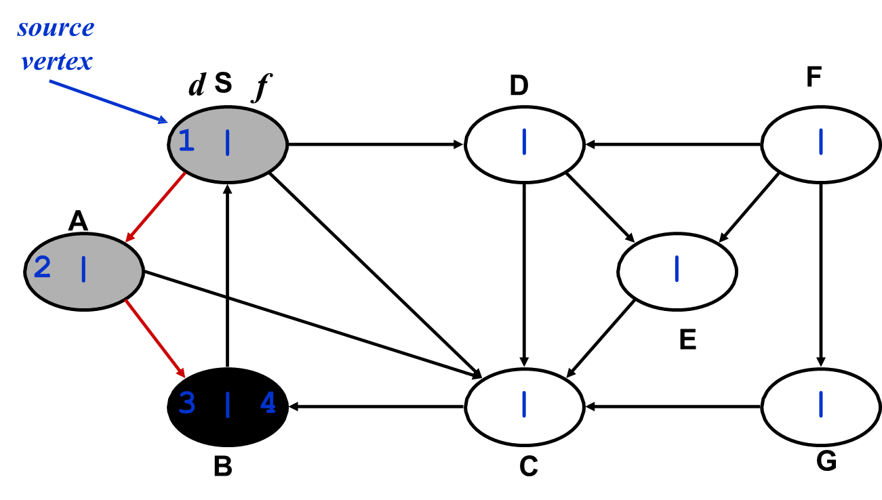
Depth-first search (Simulation 2)
20/23

Slide 35
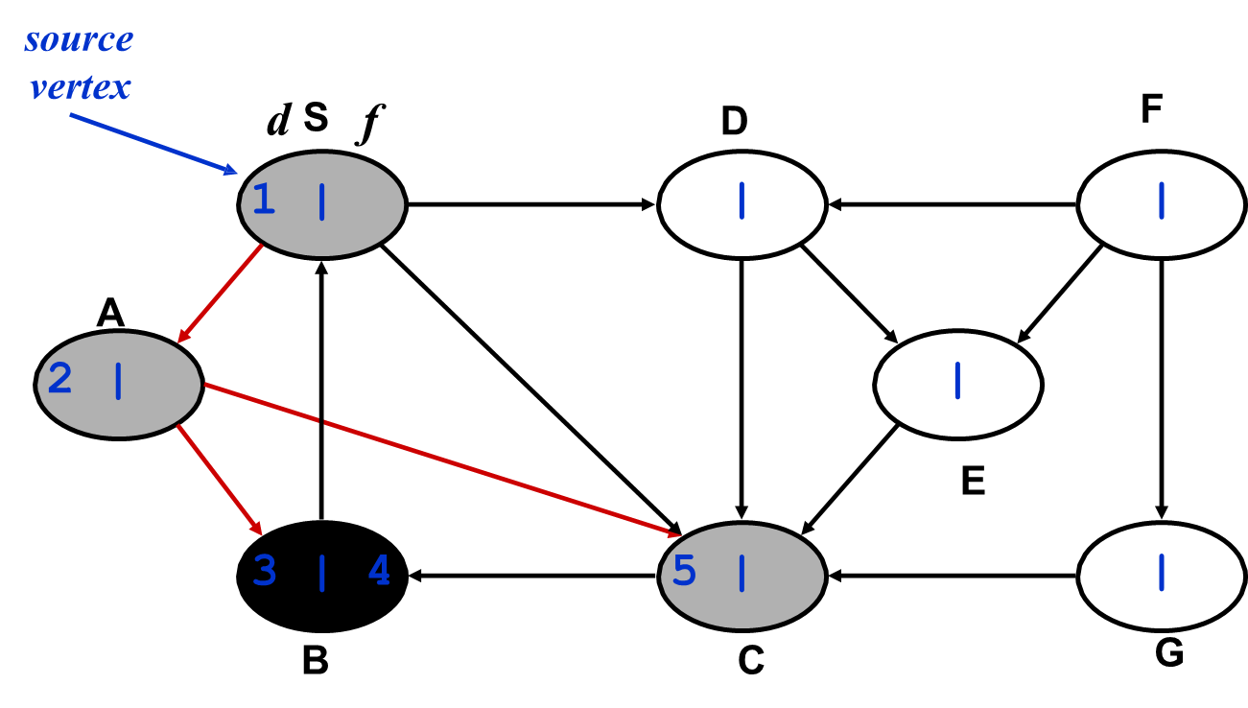
Depth-first search (Simulation 2)
20/23

Slide 36
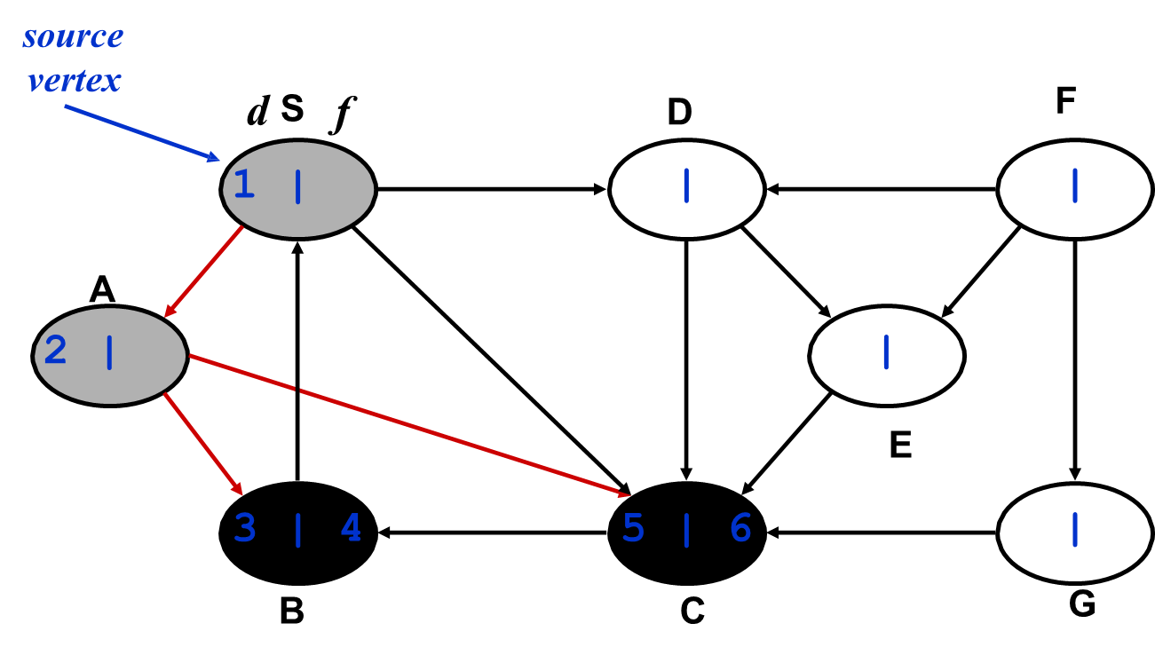
Depth-first search (Simulation 2)
20/23

Slide 37
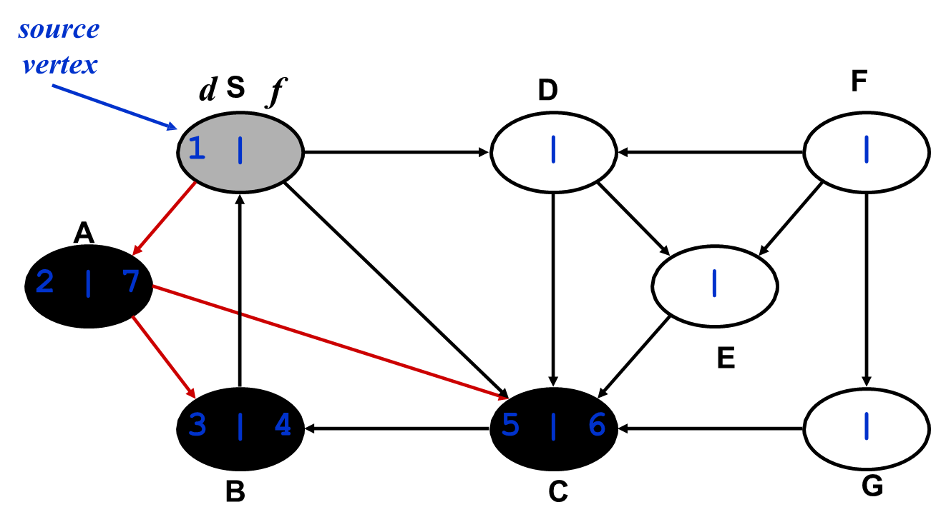
Depth-first search (Simulation 2)
20/23

Slide 38
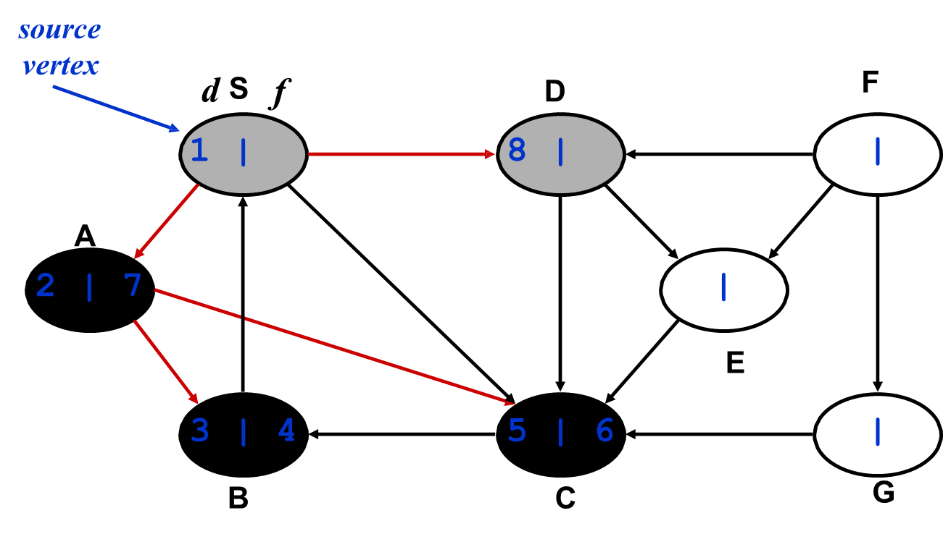
Depth-first search (Simulation 2)
20/23

Slide 39
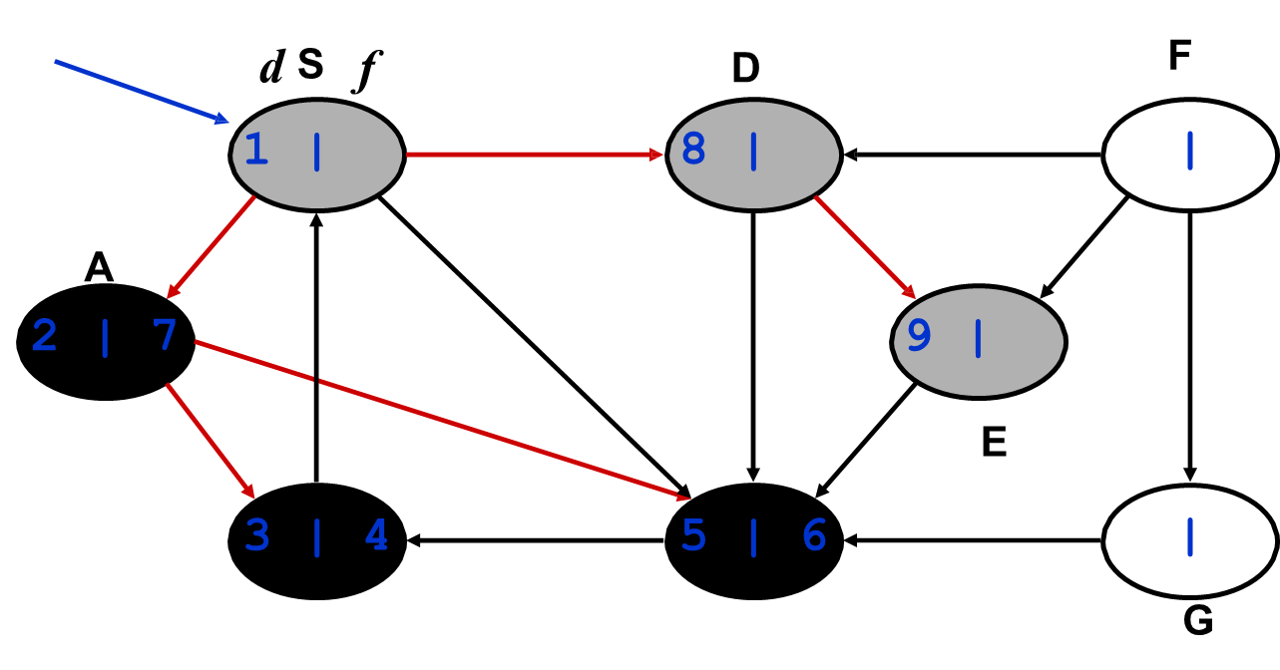
Depth-first search (Simulation 2)
20/23

Slide 40
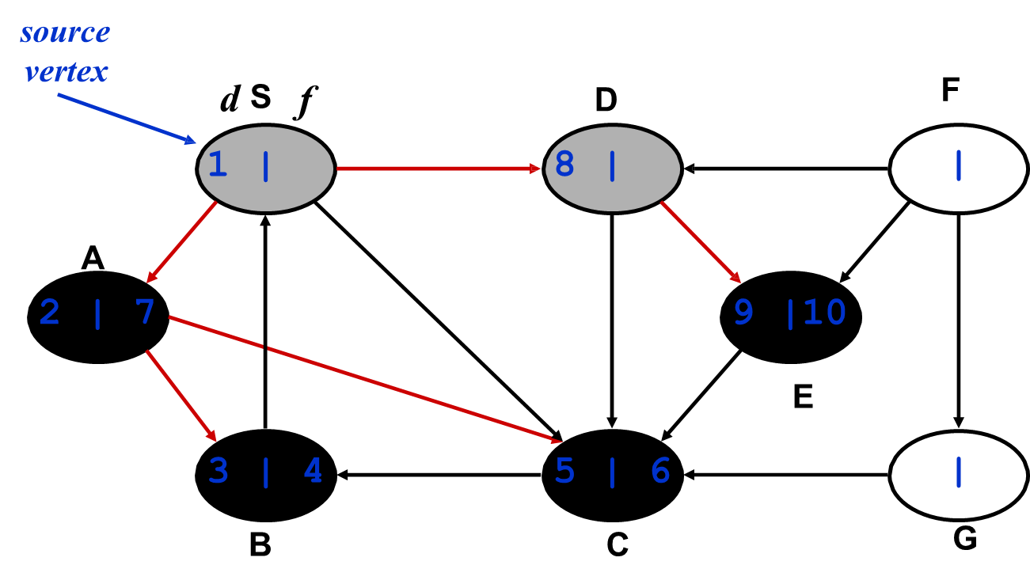
Depth-first search (Simulation 2)
20/23

Slide 41
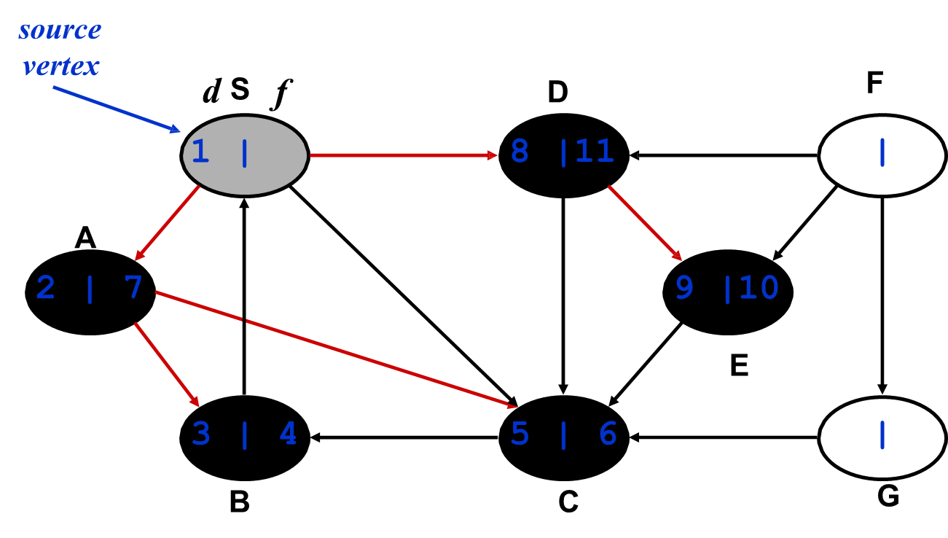
Depth-first search (Simulation 2)
20/23

Slide 42
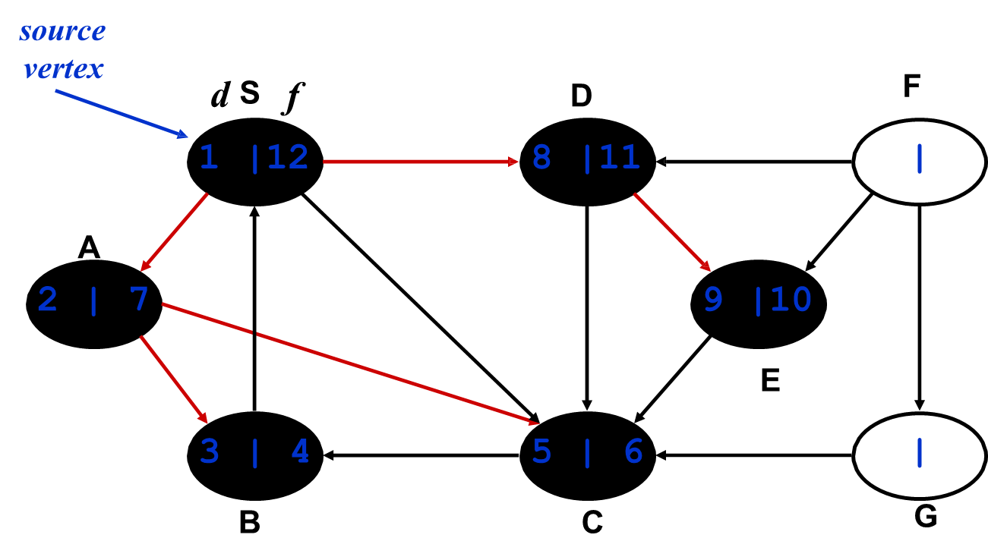
Depth-first search (Simulation 2)
20/23

Slide 43
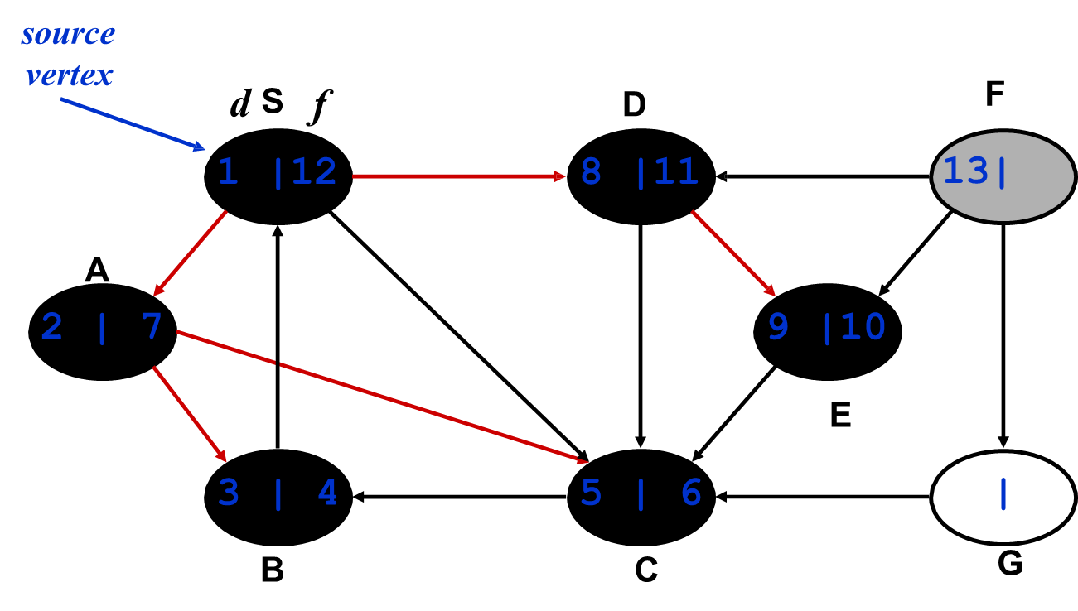
Depth-first search (Simulation 2)
20/23

Slide 44
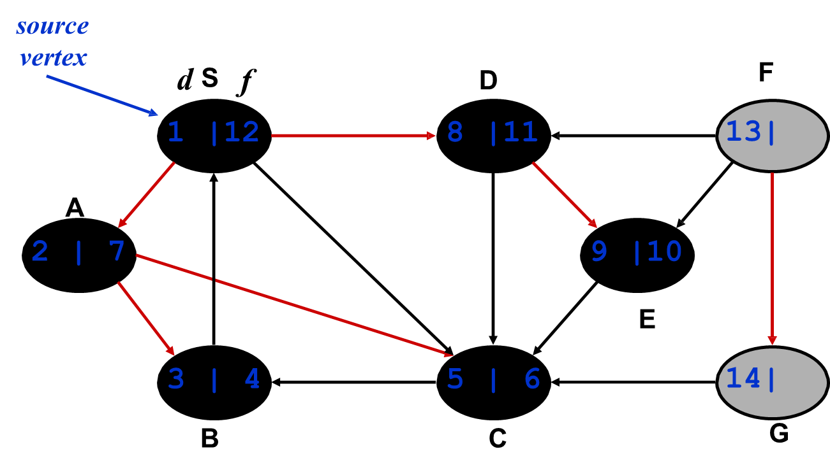
Depth-first search (Simulation 2)
20/23

Slide 45
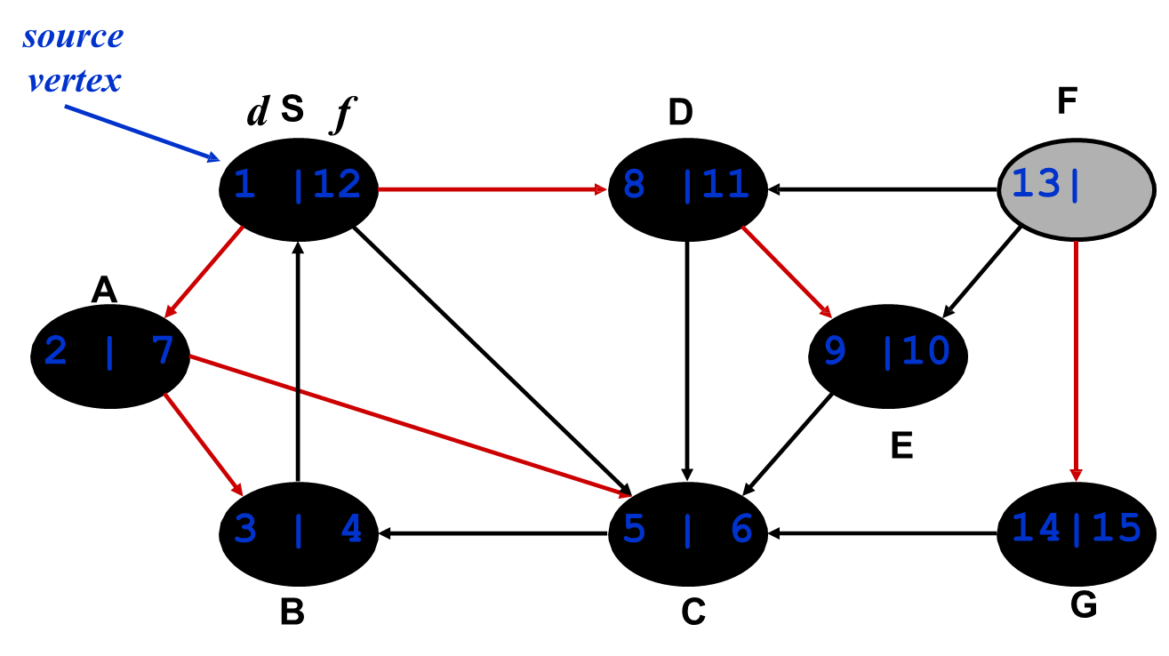
Depth-first search (Simulation 2)
20/23

Slide 46
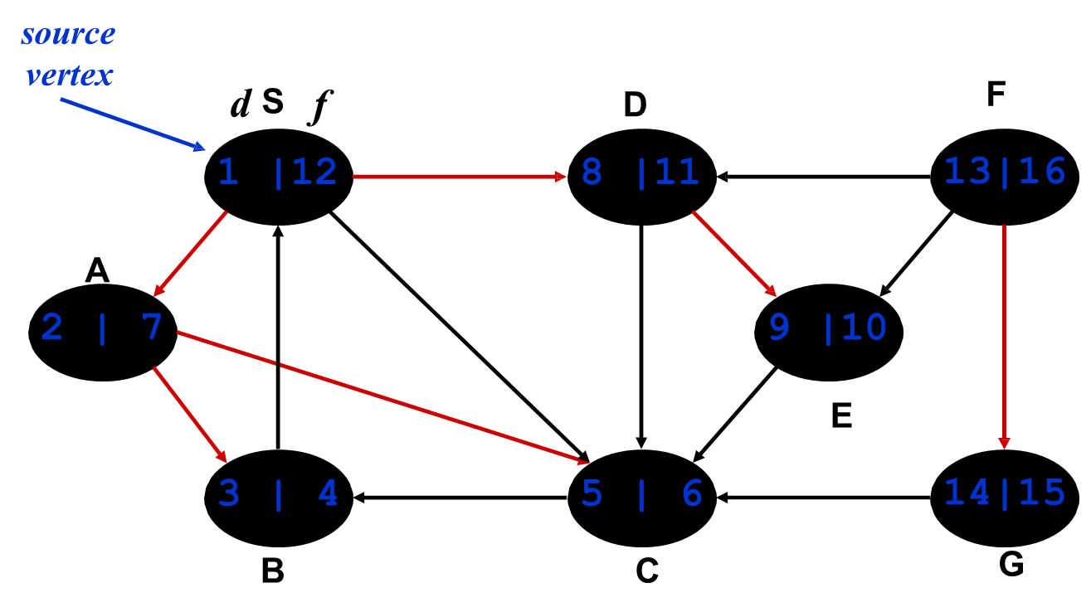
Depth-first search (Simulation 2)
20/23

Slide 47
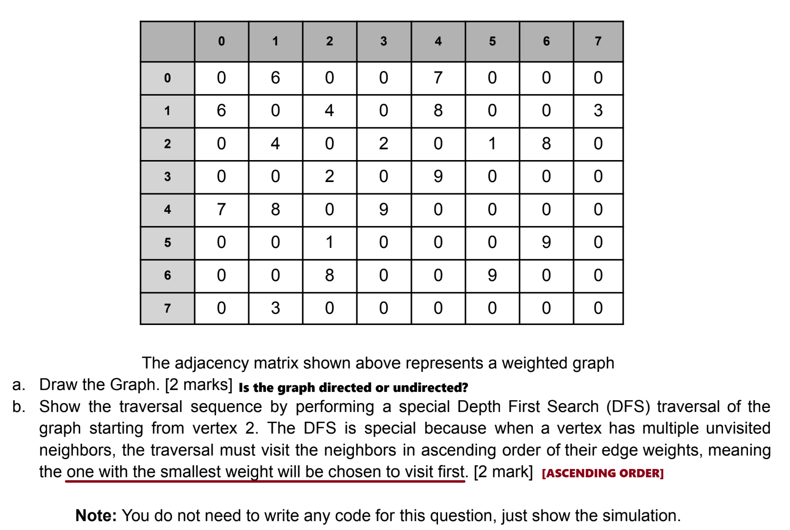
Homework
20/23

Slide 48
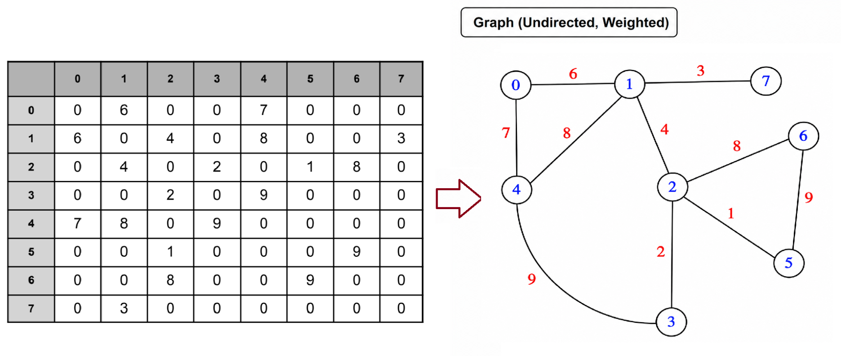
Homework
The graph is undirected (bidirectional) since the adjacency matrix is symmetric (A[i][j]=A[j][i]).
Thus, each edge is represented twice (e.g., 0↔6).
20/23

Slide 49
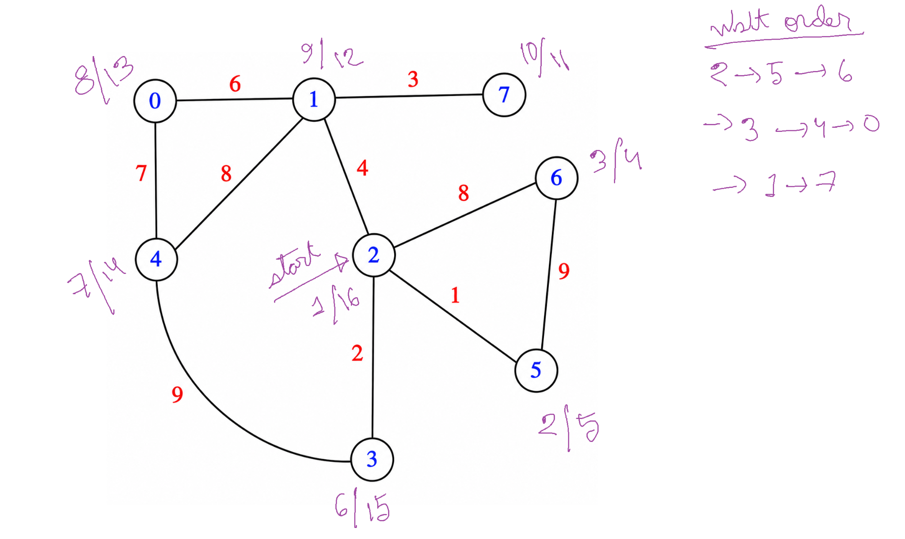
Homework
Traversal rule: Visit neighbors in ascending order of edge weights;
the smallest-weight edge is chosen first.
20/23

Slide 50
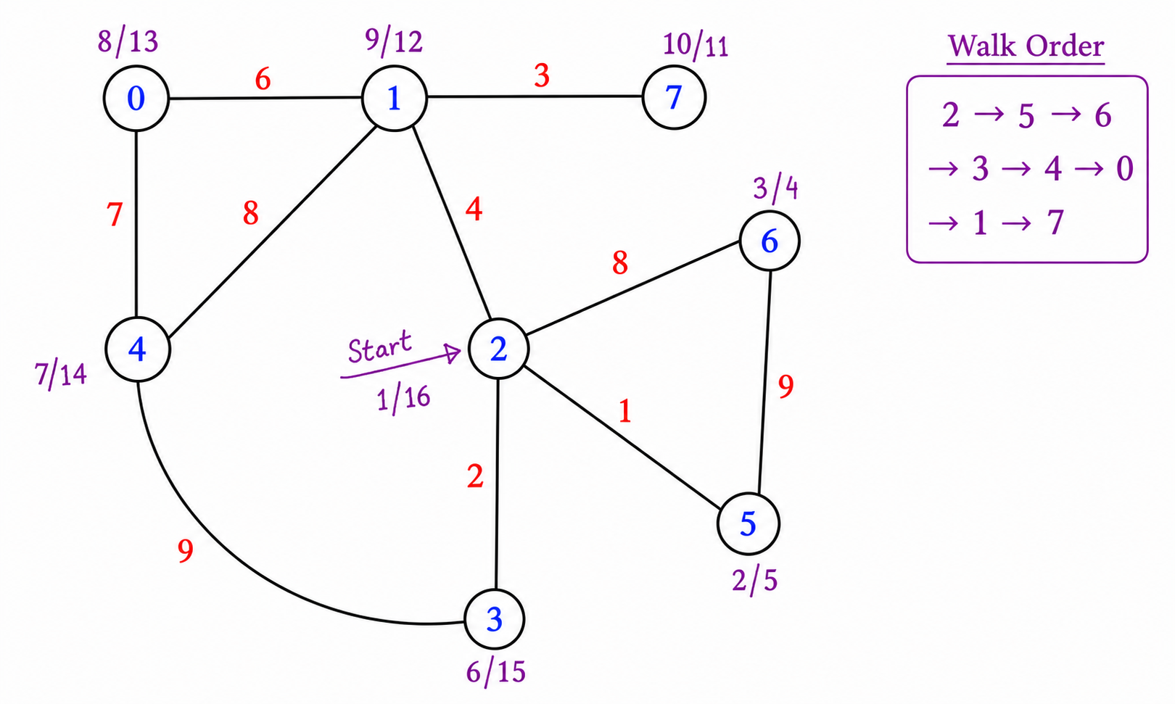
Homework
Traversal rule: Visit neighbors in ascending order of edge weights;
the smallest-weight edge is chosen first.
20/23

Slide 51
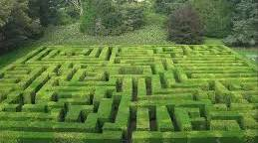
Applications of DFS
(Just know that these can be done)
Topological Sorting: Ordering vertices in a directed acyclic graph (DAG).
Strongly Connected Components (SCC): Identifying subsets of vertices where every vertex is reachable from every other vertex.
Cycle Detection: Detecting cycles in directed graphs using back edges.
Path Finding: Finding paths between vertices in a graph.
Solving puzzles/mazes: Like the Knight’s Tour problem or Sudoku.
Implementation will be covered in CSE221
20/23

Slide 52
Use the following link to generate and traverse graphs: https://visualgo.net/en/dfsbfs
Interactive Graph Traversal with VisuAlgo

Slide 53
The End

